Slide 1
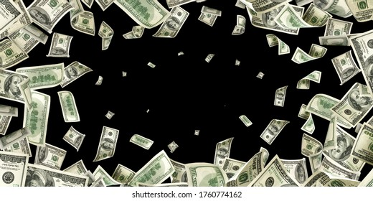
DE-DOLLARIZATION
-Is the world moving away from the US dollar?

Slide 2

Introduction:
For more than seven decades, the US dollar has been the cornerstone of the global financial system, facilitating international trade, investment, and foreign exchange reserves. Its widespread acceptance has provided stability to global markets while also granting the United States significant economic and geopolitical influence. However, the rapid rise of emerging economies, shifting geopolitical alliances, and efforts to reduce dependence on a single dominant currency have accelerated the process of de-dollarization. Although the US dollar continues to hold a central position in the world economy, the international monetary system is gradually becoming more diversified, with several countries expanding the use of alternative currencies in global transactions.

Slide 3

Definition: It is the gradual process where countries reduce their reliance on the U.S. dollar as the primary currency for global trade, investments, and foreign reserves.
Reducing dependence on the US dollar: Countries want to rely less on the US dollar for international trade and financial transactions.
Avoiding the impact of US sanctions: Using other currencies can reduce the effect of economic sanctions imposed through the US financial system.
Promoting national currencies: Countries encourage the use of their own currencies to strengthen their economies and increase financial independence.
Building a balanced global financial system: Many nations support a system where several major currencies are used instead of relying mainly on one currency.
Systems Boosting Local Money: Countries are establishing "Bilateral Trade Agreements" to trade in their own local currencies.
Example: India now pays for certain imports (like oil) from Russia using the Indian Rupee, and does trade with the UAE using local currencies.
Building a Balanced Global Financial SystemMultipolar World: As economies like China and India grow, they want their financial power to match their economic size.
Fairness: A balanced system prevents any single superpower from dominating the global economy or dictating terms to others.
Diversification: Central banks around the world are buying and storing vast amounts of gold to safeguard their wealth instead of holding just U.S. dollars.

Slide 4


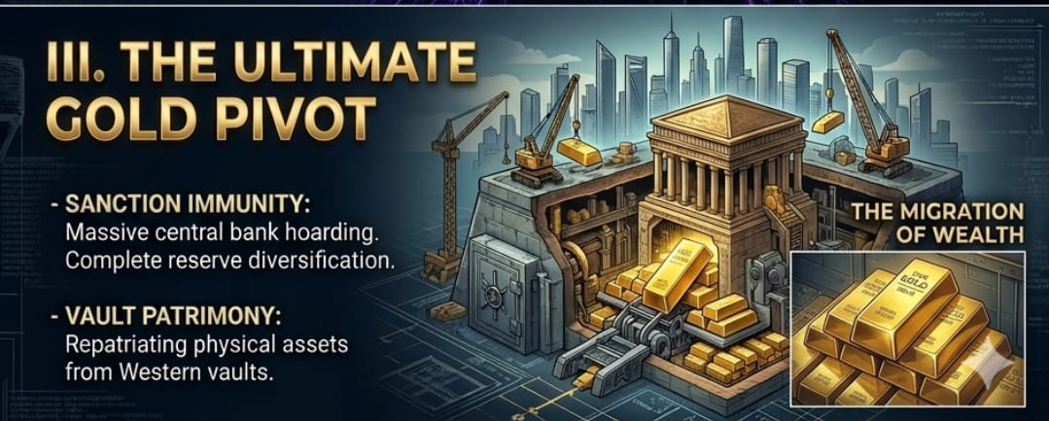
Local-currency settlement loops: Countries are bypassing the US dollar by invoicing and settling trade directly in their own currencies. We are seeing this happen right now with India and the UAE trading oil in rupees and dirhams, and China expanding the "petroyuan."Sovereign financial rails: Nations are building independent payment networks so they don't have to rely on SWIFT. Systems like China's CIPS are scaling fast to act as a parallel financial messaging system that the US cannot monitor or switch off.The gold pivot: Central banks are proactively protecting their assets from Western sanctions. Instead of buying US Treasuries, they are aggressively purchasing physical gold and pulling it back into their own domestic vaults.

Slide 5
Evidence Supporting De-dollarizationReserve Diversification: Central banks are quietly shifting reserves away from the dollar toward gold and non-traditional currencies.
Weaponization of Sanctions: Geopolitical tensions and the use of the SWIFT system as a financial weapon have pushed countries—such as the BRICS bloc—to seek monetary independence.
Bilateral Trade: Countries are increasingly settling cross-border trade in local currencies, such as China using the Yuan and India utilizing the Rupee.2.
Continued Dominance of the US DollarGlobal Trade Invoicing: Over half of all global trade is invoiced in US dollars, vastly disproportionate to the US share of global trade.
Foreign Exchange (FX) Markets: The greenback remains the undisputed king of FX markets, participating in roughly 88% of all traded daily volumes.
Debt and Finance: International credit and central bank reserves remain heavily dollar-centric, as no alternative currency currently matches the depth, liquidity, and trust of US financial markets.
Current Trends and StatisticsForeign Exchange Reserves: IMF data indicates that the dollar's share of disclosed global foreign exchange reserves has moderated to around 57%.
FX Volume: According to Bank for International Settlements (BIS) data, the dollar maintains a near-record 88% dominance in traded FX volumes, compared to the Chinese Yuan's 7% share.
Trade: The dollar dominates more than 50% of global trade invoicing, while the remaining share is slowly fracturing across the Euro, Yuan, and regional currencies.
Visual Suggestion: Include a side-by-side donut chart highlighting global FX Volume Share (showing the 88% USD majority versus other currencies) alongside a bar graph tracking the gradual, long-term decline in USD global reserve shares over the last two decades.

Slide 6
Advantages:Reduces excessive dependence on the US dollar.Strengthens national currencies and financial sovereignty.Lowers exchange-rate risks and transaction costs.Encourages regional economic cooperation and diversified trade.Makes the global financial system less dependent on a single currency.
Challenges:The US dollar remains the world's most trusted and widely accepted reserve currency.US financial markets are deep, liquid, and highly stable.Most global commodities, including oil and natural gas, continue to be priced in US dollars.Alternative currencies such as the Chinese Yuan and Euro still have limited global acceptance compared to the dollar.Replacing the dollar completely would require major changes in global financial institutions and investor confidence.
Conclusion:De-dollarization is not a sudden replacement of the US dollar but a gradual transformation of the global monetary system. While many countries are increasing the use of local currencies and diversifying their reserves, the US dollar continues to dominate international trade, finance, and investment. The future is likely to witness a multipolar financial order, where several major currencies coexist and share a greater role, rather than one currency completely replacing the US dollar.

Slide 7
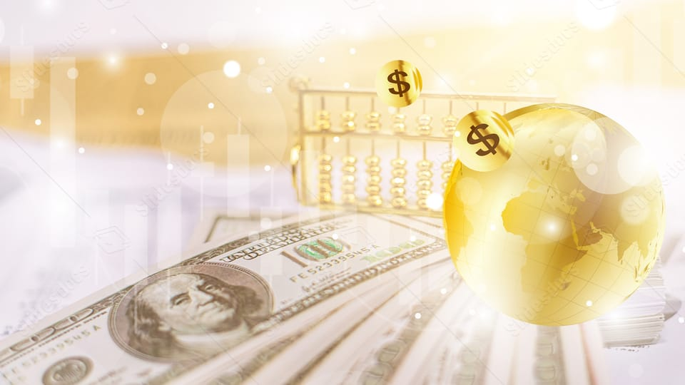
Thank You
Group members
-Sneha Mondal
-Aishi Dutta
-Abhisikta Ghosh
-Anwesha Bhowmick
-Sudeshna Saha
Notes:
Thank You

